Slide 1

Agile Transition to SAP S4HANA with SAP Solution Manager and Focused Build
1093
Henrik Zimmermann, Reiner Markheiser, Joerg Marenk, SAP

Slide 2
Agenda
Introduction
SAP Readiness Check Analysis
Prepare your project and run Easy Project Setup to create the project agenda
Define Initial and Product Backlog
How to do project reporting with Focused Build

Slide 3

Introduction

Slide 4

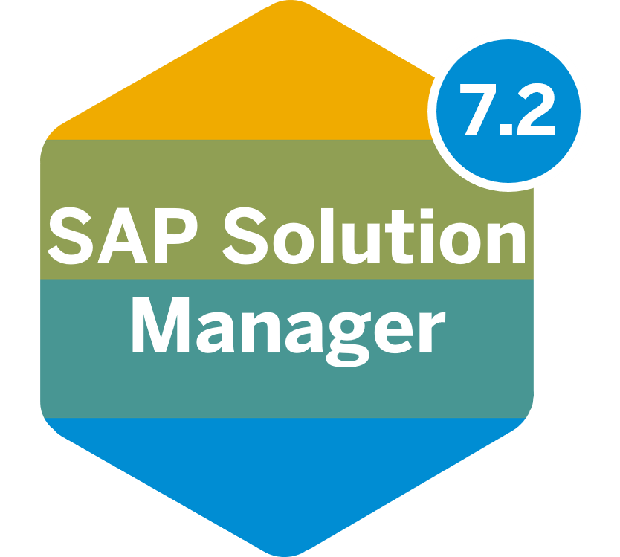
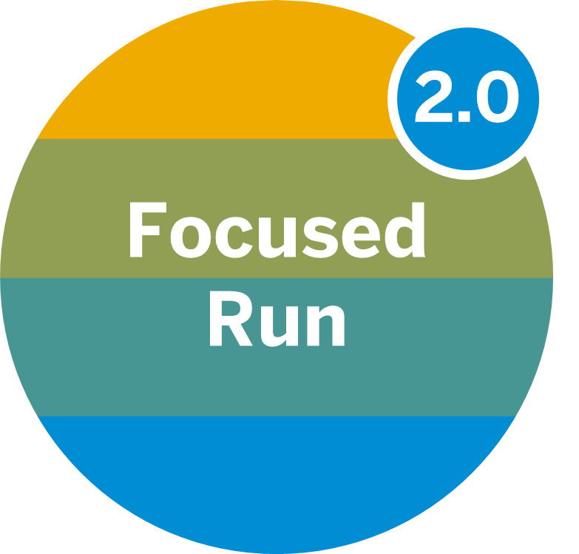


The Application Lifecycle Management Product Portfolio of SAP
SAP Solution Manager available for hybrid customer solutions
Focused Run available for hybrid customer solutions
SAP Cloud ALM available for SAP S/4HANA Cloud
+
Fully integrated ALM suite for on-premise-centric medium and larger customers
Application Operations for service providers and large / very large customers
Starting with the Implementation portal for cloud-centric small and medium customers
Notes:
SAP Cloud ALM Is latest kid on the block
SA Cloud ALM is today available as an implementation portal for S4HANA cloud
When we provision a starter tenant for S4HANA cloud, we also invite you to SAP Cloud ALM.
We have a Minimal viable scope only so far, only process and task management, only one product connected – S4HANA cloud
Although we are only live with a minimal viable scope, we have already 50 live customers and the first customer references: Crowdfarmx
Who ever heard about it? A Startup implemented full SAP S/4HANA Cloud scope in 10 weeks with SAP Cloud ALM 5 people in IT
It is a small customer, the complete opposite to a typical SAP Solution Manager.

Slide 5
Three Different Change Paces in Requirements-to-Deploy
S/4HANA Conversion Project Support provided with Focused Build SP06 as additional starting point for Requirements-to-Deploy
Portfolio to Project
Detect to Correct
Requirements-to-Deploy
Fix
Trigger | Business disruption or standard change
Scope | Small
Process Impact | None
Approval | Individual
Deployment | Unbundled on request or bundled with release
Time to delivery | 1 day – 1 week
Request to Fulfill
Innovate
Trigger | Transformation projects, new solutions
Scope | Large
Process Impact | Significant
Approval | Pre-Approved
Deployment | Bundled with release
Time to delivery | 3-12 months
Requirements-to-Deploy
accelerated by
Fix
Innovate
Requirements-to-Deploy
Requirements-to-Deploy
Enhance
Enhance
Trigger | Improvement request
Scope | Medium
Process Impact | Minimal
Approval | Individual
Deployment | Bundled with release
Time to delivery | 1 month
Enhance
accelerated by

Slide 6
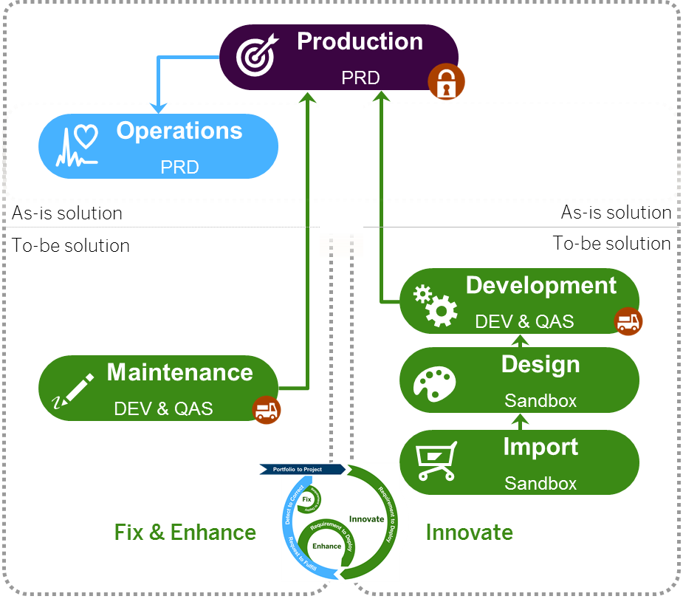
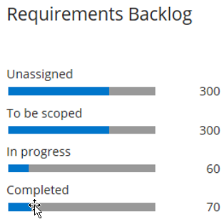
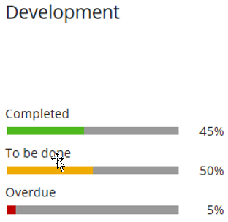
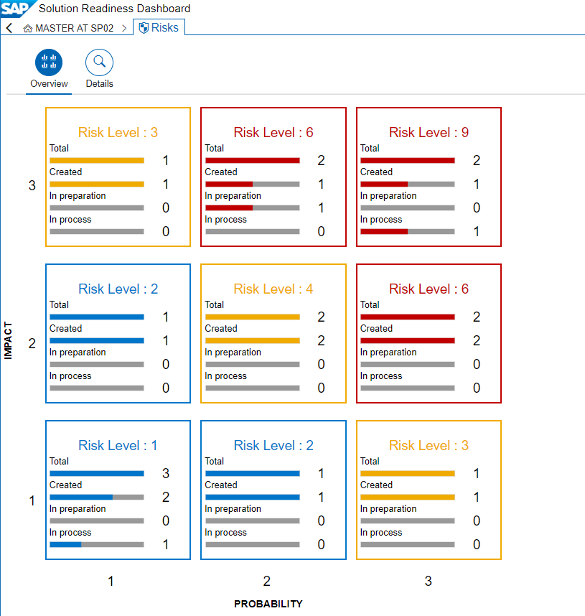

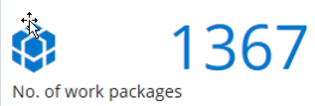


Focused Build – Architecture Overview and Integration Model
Release Management
Change Control Landscape
Release Number and Cycle
Process Management
Requirements / Work Packages / Work Items
Project Management
Wave 1


Process and Application Landscape

Requirements
Work Packages

Sprint 1…n
Design Documents
Task 1…n
Work Items
Branches
Milestone
Test Suite

Q-Gate
Test Plan
Test Cases
Test Package
Solution Readiness Dashboard

Slide 7

The Way to S/4HANA - Greenfield or Brownfield?
Greenfield
With a new implementation, you build a new SAP S/4HANA system.
Either you cut over to the new system (the so-called “big bang” scenario)
or
you migrate the individual business units sequentially from your legacy SAP ERP application to the new system (“a phased rollout”).
Brownfield
With a system conversion, you turn your existing SAP ERP system into an SAP S/4HANA system.
Technically, the system conversion is a one-step procedure with a single downtime.
95% of all customers decide for one of these both options.
Notes:
About 5% choose other options because of their specific situations and requirements (“Selective Data Transitions”, also called Bluefield).

Slide 8
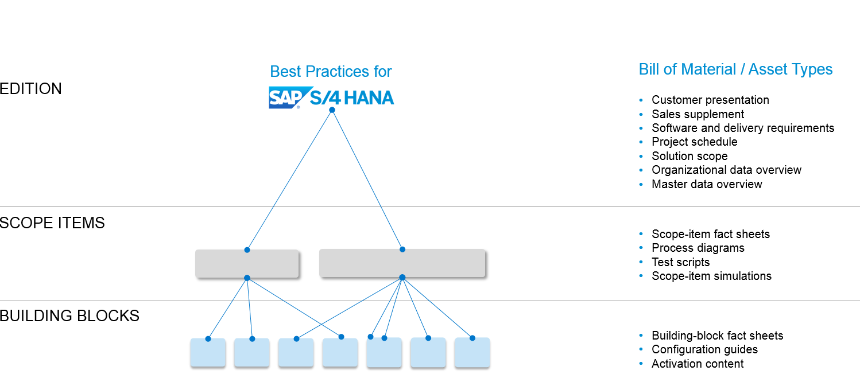
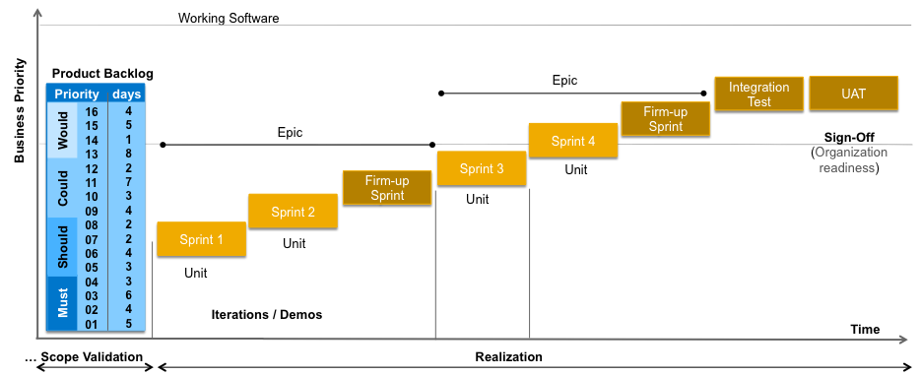
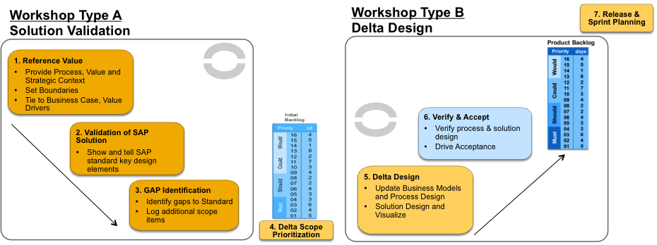
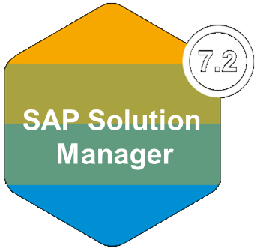
How to start Greenfield Projects: Use SAPs Predefined Content Model Company and Best Practices
Start with SAP’s Rich Best Practices Early available in the project!
Solution Validation instead of traditional Business Blueprint
Fit/Gap workshops with customer at the steerwheel to drive priorities
Agile Build
Tailor the solution in short time-boxed sprints with frequent inspection points by the customer
+
+
- Import SAP BP processes and content ( e.g. SAP Model Company)
- Model Business processes - Collect Requirements for each gap / WRICEF - Build a Work package backlog
- Define Waves & Sprints - Break Down Work in Work items and tasks - Perform short iterations of dev, config & testing
Notes:
If you go down to the bones, those are the three major acceleration techniques been used in activate.(explain all three).
1)The customer starts with a preconfigured system, with pre-installed organizational structure and master data, ready to demo
and documented with process mdoels
2 This speeds up the explore phase, compared to the traditional business blueprint, specifically if there is a high fit and the customer is willing to adopt standard processes from SAP. We develop in that case a so called product backlog list. This is a prioritizes gap list
3) Agile build - to build according to the customer expectations.
The customer drives the priorities, drives acceptance, by using Agile concepts:
-Product ownership
-Show & tell
-Definition of ‘Done”
This is not be by definition faster, but the risk of rework is less, so the project carries lower risks to fail. Prerequisite is customer commitment, stable team and so on, which has to be discussed and agreed with the customer upfront of the project. Preferably in the bidding phase.

Slide 9









How to start Brownfield Projects: S/4HANA Conversion Project Support Integration Readiness Check in Focused Build
Focused Build
Focused Build Project
SAP Readiness Check for SAP S/4HANA
Focused Build Requirement
Excel Export/Import
Simplification Item
Management UI5 App
Evaluation and Categorization of Activities
Focused Build Work Package

Slide 10
SAP Readiness Check Analysis and Simplification Item Management

Slide 11


Analyse your existing SAP ERP Landscape
Analyse
usage and configuration data of your current landscape
Determine
conversion compatibility and required preparation steps
Access
results in interactive dashboard for easy analysis

Slide 12










Covered Aspects
Active Business Functions
Find out how many business functions are
active in your system and whether they are
compatible with SAP S/4HANA.
Add-on Compatibility
See how many add-ons are installed in your
system and whether they are still compatible
with SAP S/4HANA.
Recommended SAP Fiori Apps
Identify the SAP Fiori apps that best fit your needs based on your historical transaction volume and usage.
Business Warehouse Extractors
View how many extractors for SAP Business Warehouse exist in your ERP system and if they work with SAP S/4HANA.
Simplification Items for SAP S/4HANA
View new and updated data structures / architectures in SAP S/4HANA to determine if they are relevant to your processes.
Business Process Analytics
Analyse the state of your processes to determine any clean-up requirements before migrating to SAP S/4HANA.
Custom Code Analysis
Analyse the impact of custom code by knowing which SAP objects have been changed or removed in SAP S/4HANA.
SAP Custom Development Projects
View solutions built for your business by SAP Custom Development to evaluate if needed with SAP S/4HANA.
Data Volume Management
Plan for migration with insight into the size of your existing database and archiving potential for 12 or 24 months
Sizing for SAP S/4HANA
Estimate your sizing for the initial installation based on the existing system and after a data clean-up.

Slide 13
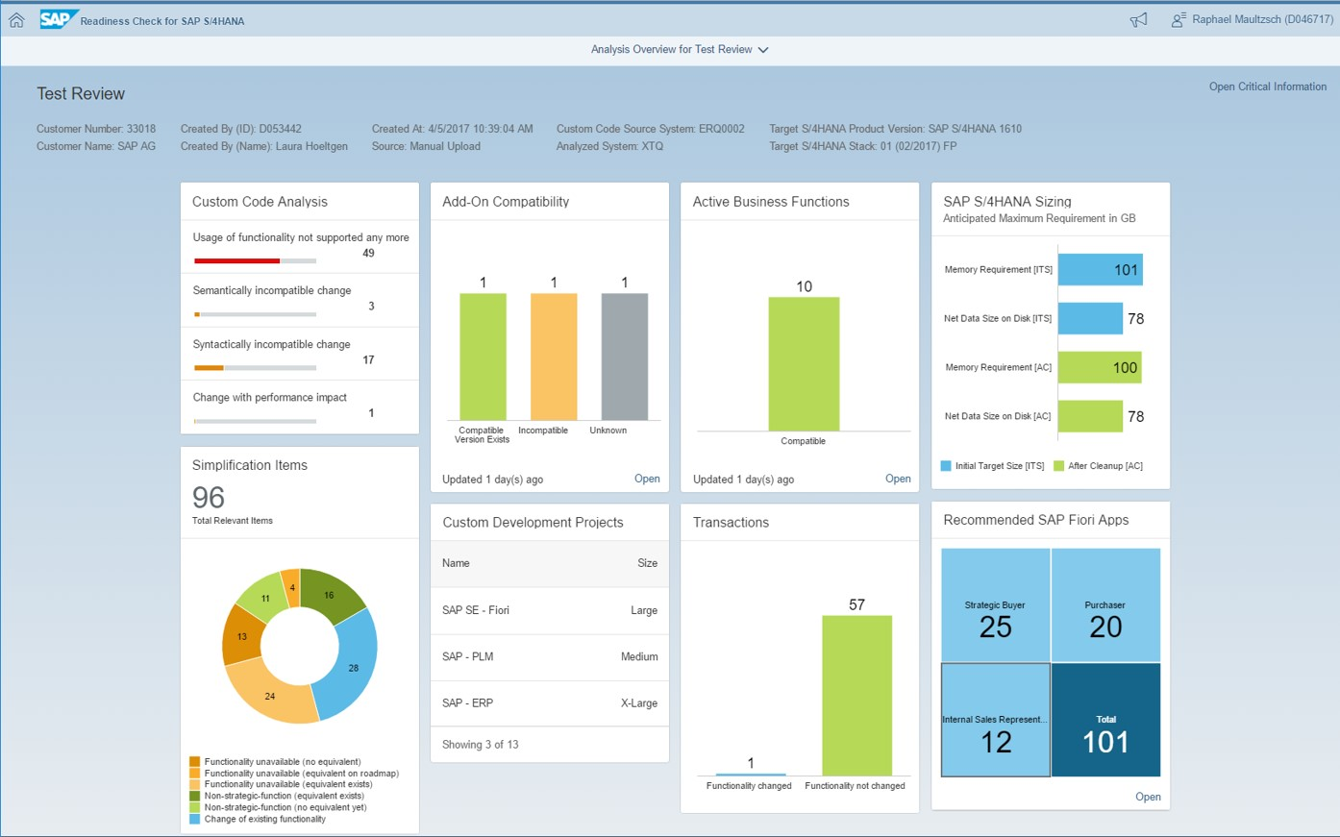
Interactive Dashboard shows Readiness Check Results
Detailing the respective Activities related to each Simplification Item
Categorizing Activities in mandatory, conditional or optional
Sequencing Activities into project phases
Integration with SAP ABAP Test Cockpit to visualize the detailed ATC analysis inside SAP Readiness Check 2.0
When the Readiness Check is finalized it can be exported as zip-file

Slide 14
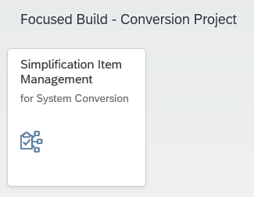


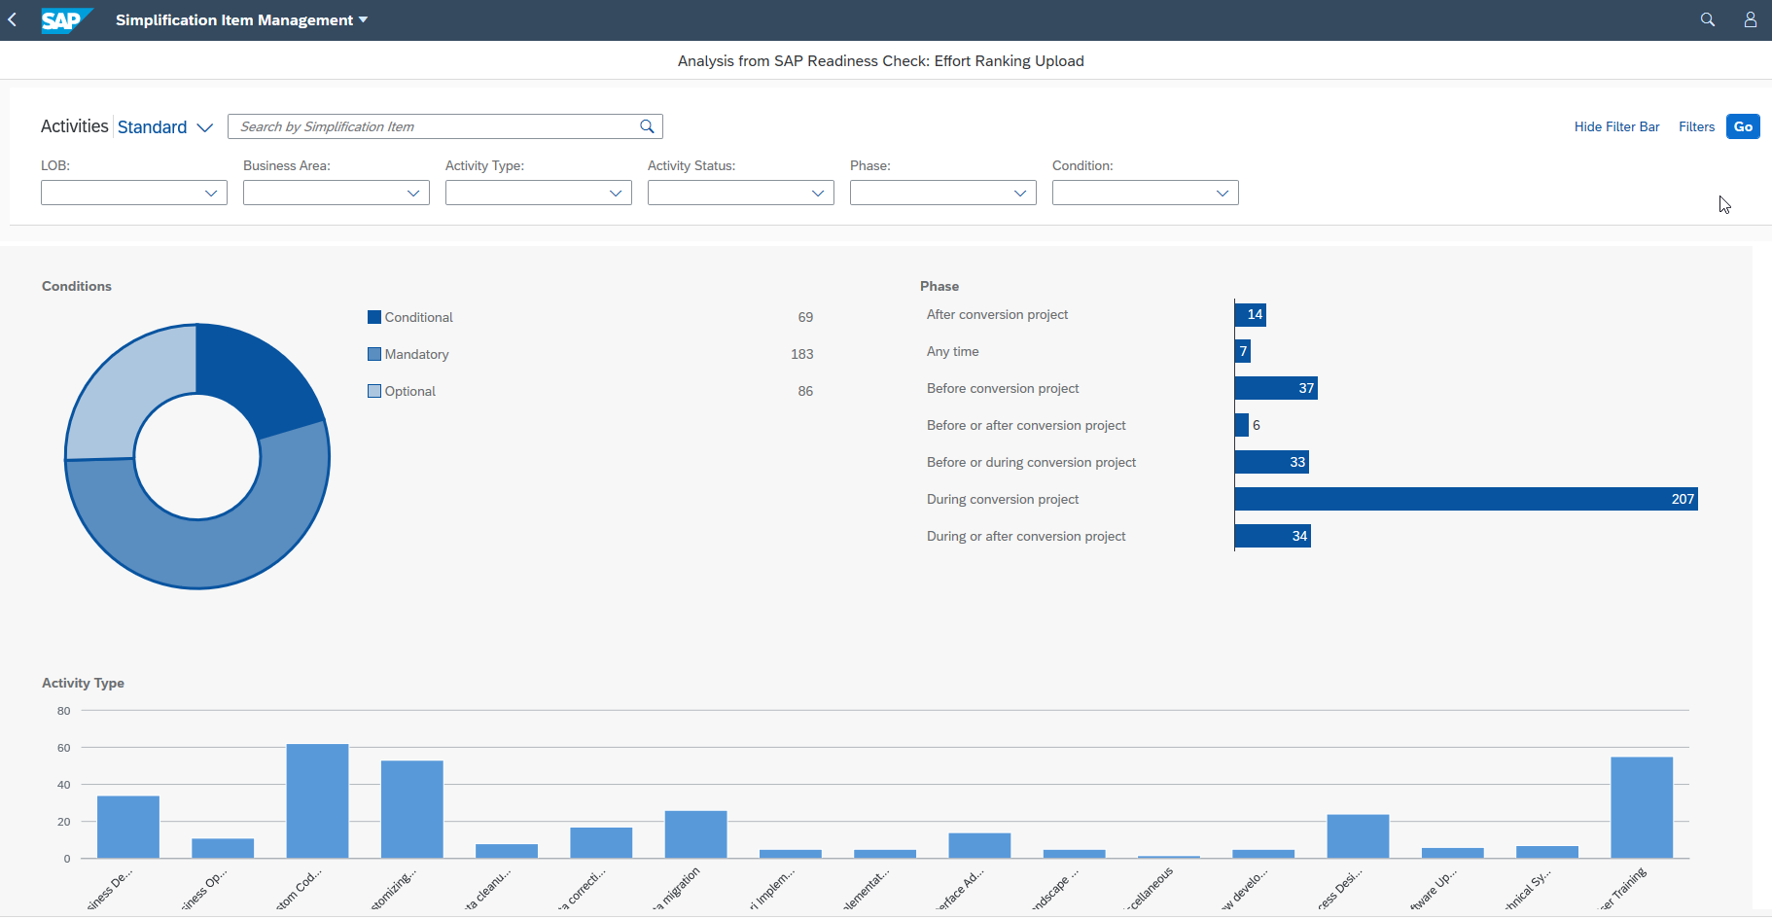

Upload of SAP Readiness Check in Focused Build
The zip-file is used for importing the Readiness Check Result into Focused Build
The Simplification Items and Activities are created in the background
Related Information like Activity Type, LoB, Business Area or Manual Status are visible in the tool
Is the starting point for the planning of the next project steps in Focused Build
Direct creation of Requirements or Work Packages out of Activities or assignment of Focused Build Projects
Tight integration in Focused Build Workflows with automatic status update
Zip

Slide 15
Simplification Item Management UI5 Application
Graphical display of Simplification Items and related Conversion Activities by Condition, Phase, Type, Status and Follow-Up Type
Table display with all Simplification Items and related Conversion Activities and their most-important information
Powerful and fast multi-filter options
Direct Creation of Follow-Up Requirements or Work Packages and Assignment of Focused Build Projects
Postponement or Rejection of non-required Activities directly possible from the UI5 application

Slide 16
Demo - Upload Readiness Check zip file to Solman into Simplification Item Mgt. (already prepared for later exercises)

Slide 17
Prepare your project and run Easy Project Setup to create projects

Slide 18
Project Organization Example Using Master / Build Projects
Master Project (Program)
Steering Committee
Project Sponsor
Project 3 - n
PMO Office
Architecture
Program and Project Management
Quality Management
Build Project 1
Build Project 2
Application Area 1
Application Area 2
Technical Infrastructure
Migration Management
Organizational Change Management
Template Type: Build Project
Template Type: Master Project

Slide 19
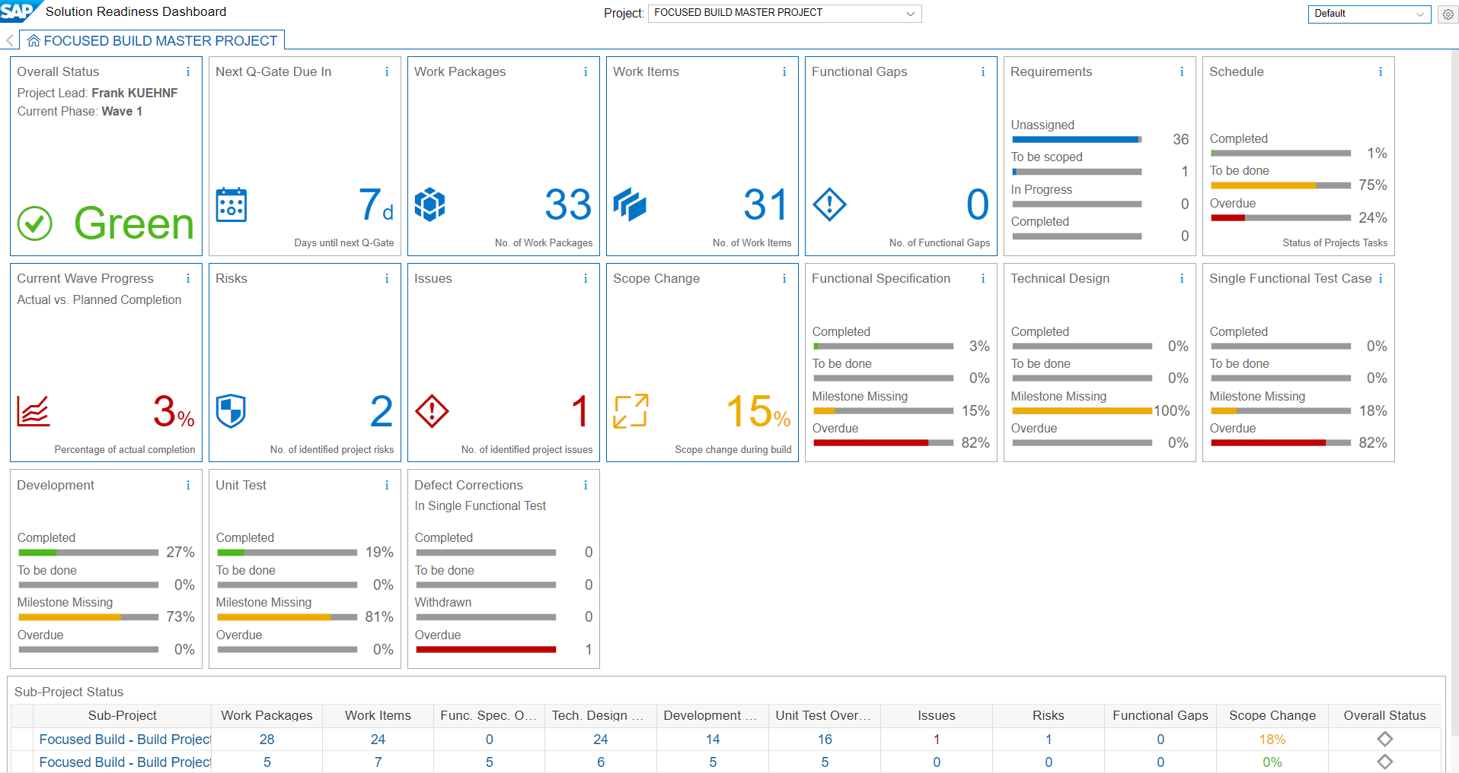
Solution Readiness Dashboard
Aggregated view for all Build-Projects assigned to Master Project
Aggregated data per Build Project

Slide 20
Transparent Requirements-to-Deploy Incremental Deployment with constant Feedback Loops with the Business

Releases synchronize project go-lives and ensure continuous delivery and integration.
Agile Releases

Project to bundle deliverables Multiple and parallel projects are possible
Projects
Functional Integration Test
Regression Test
Phases ending with Quality Gates. Short prepare and scope, incremental build

Prepare
Explore
Realize
Deploy
Run

Waves ending with Touch and Feel by the business (~ 8-12+ weeks)
Acceptance Test
Single Functional Test
Waves

Sprints with Show and Tell sessions to the business (~ 2-4 weeks)
Unit Test
Sprints

Slide 21
Example for schedule of Releases, Projects, Waves and Sprints Use Case: Two Releases per project, two Waves, and three Sprints per Wave
Year
JAN
FEB
MAR
APR
MAI
JUN
JUL
AUG
SEP
OCT
NOV
DEC
Release Schedule
Major Release 1.0
Major Release 2.0
Master Project
Phases
Waves
Build Project 1
Phases
Waves
Sprints
Build Project 2
Phases
Waves
Sprints
Build
Deploy
Prepare
Test
Hypercare
Operation
1.0
Build
Deploy
Prepare
Test
2.0
Discover & Prepare
Explore
Realize
Deploy
Wave 1
Wave 2
Discover & Prepare
Explore
Realize
Deploy
Wave 1
Wave 2
Sprint 1
Sprint 3
Sprint 2
Sprint 1
Sprint 3
Sprint 2
Discover & Prepare
Explore
Realize
Deploy
Wave 1
Wave 2
Sprint 1
Sprint 3
Sprint 2
Sprint 1
Sprint 3
Sprint 2
Quality Gates
n.n
Release Number Go-Live date

Slide 22

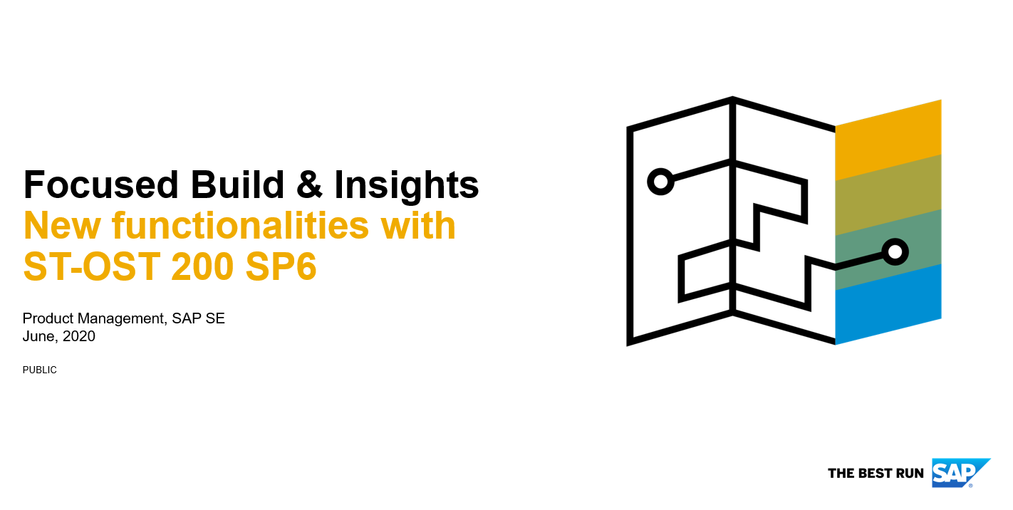
Agile Transition to SAP S4HANA powered by SAP Solution Manager
SAP Readiness Check
SAP Solution Manager – Focused Build
Simplification Items
Focused Build Project
Focused Build Project
Activities


Activities

Wave 1
Requirements
Work Packages

Activities

Sprint 1…n
Work Items

Slide 23
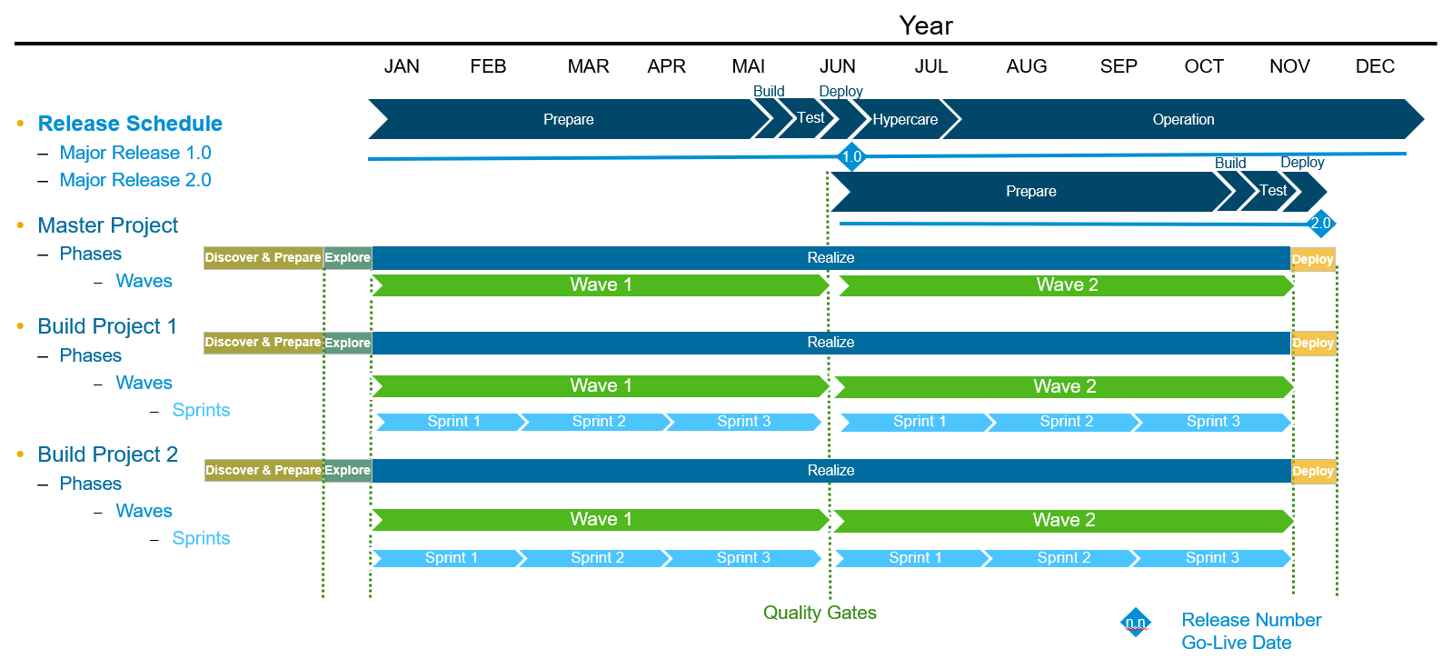
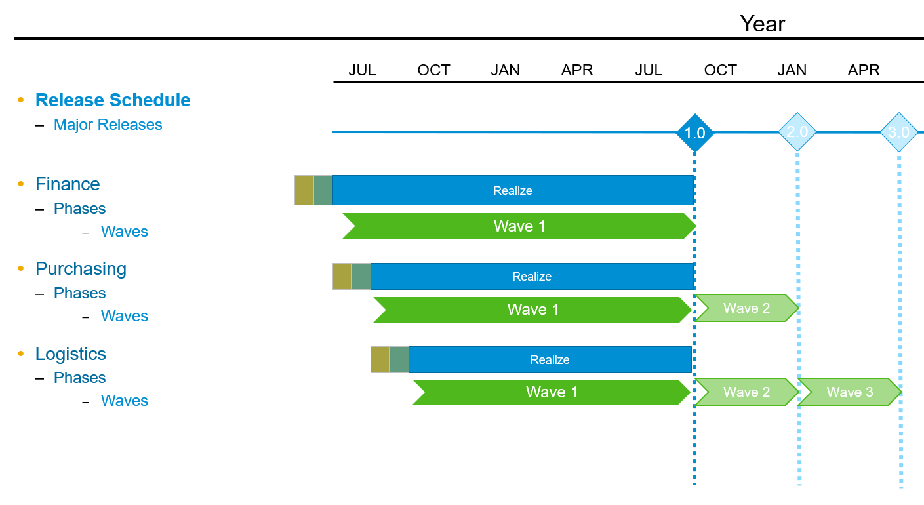
Project Planning Options to create Focused Build Projects
Synced schedule across Master / Build projects or Single projects with continuous Waves and Sprints
Easy Project Setup*
* new with Focused Build SP06
Individual schedule per project with individual durations for Waves or Sprints
Manual Project setup

Slide 24
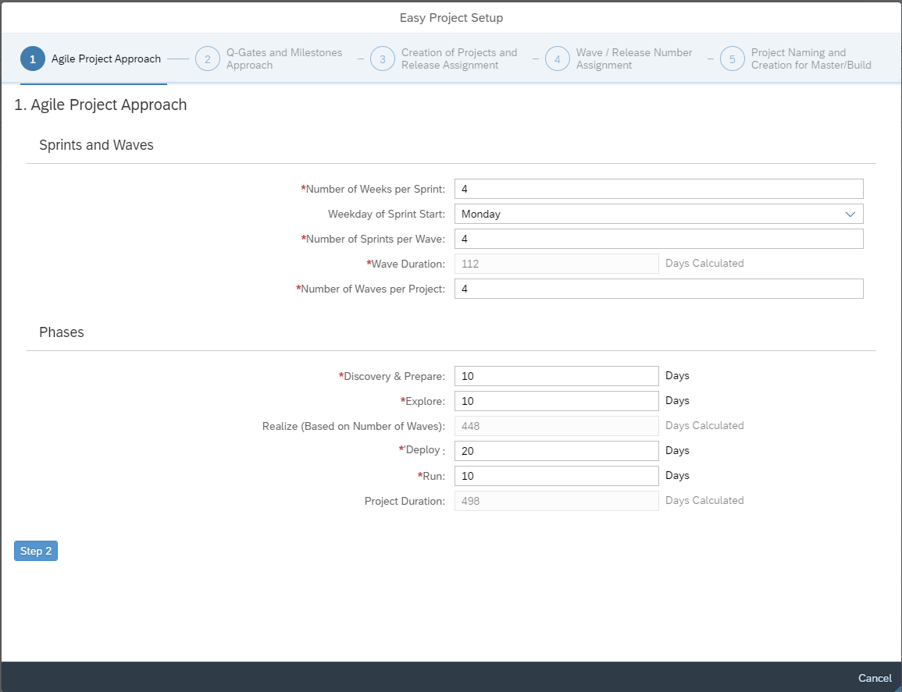
Easy Project Setup
Application
Easy Project Setup is a new wizard to create and schedule Focused Build projects
Feature details
Options to provide synchronous schedule for multiple Master/Build projects or Single project
Synced timing of sprints, waves, phases and related Q-Gates / Milestones
Release Assignment and Wave relationships
Benefits
Very efficient way to prepare your upcoming Focused Build projects

Slide 25
Demo - Show and evaluate Readiness Check Analysis - Explain Project concept / Release structure Exercise 1 - Run Easy Project Setup to create projects and Waves / Release assignment

Slide 26
Project & Release Management and Schedule
Project Phases
Dec 1
Dec 15
Jan 4
Feb 15
March 29
May 10
May 21
Discover & Prepare
Explore
Realize
Deploy
Wave 1
Wave 2
Wave 3
Sprint 1
Sprint 2
Sprint 1
Sprint 2
Sprint 1
Sprint 2
Releases
1.0
2.0
3.0

Slide 27
Project Management Structure and mapping to Releases Synchronous project, wave schedule and release deployment
Standard Master / Build Project Structure:
 | Master Project | Build Project 1 | Build Project 2 | Change Control Landscape / Release Cycles
Project Name | S4/4HANA Conversion | Finance | Human Resources | S4_TECHED
Number of Weeks per Sprint | 3
Number of Sprints per Wave | 2
Number of Waves per Project | 3
Start date of Project | December 1, 2020
Duration Discovery & Prepare phase (days) | 14
Duration Explore phase (days) | 20
Duration Realize phase (days) | 126 (based on # of Waves/Sprints)
Duration Deploy phase (days) | 11
Duration Run phase (days) | 20
Project/Wave/Release Mapping | Wave 1 |  |  | 1.0 (GoLive: February 15, 2021)
 | Wave 2 |  |  | 2.0 (GoLive: March 29, 2021)
 | Wave 3 |  |  | 3.0 (GoLive: May 21, 2021)

Slide 28
Visualized schedule of Releases, Projects, Waves Example: Synchronous project, wave schedule and release deployment
2021
Release Schedule
Major Releases
S4/4HANA Conversion
Phases
Waves
Finance
Phases
Waves
Human Resources
Phases
Waves
JAN
FEB
MAR
May
1.0
2.0
3.0
Discover & Prepare
Explore
Realize
Deploy
Wave 1
Wave 2
Wave 3
Discover & Prepare
Explore
Realize
Deploy
X.X
Release Number Go-Live date
Wave 1
Wave 2
Wave 3
Discover & Prepare
Explore
Realize
Deploy
Wave 1
Wave 2
Wave 3
Quality Gates

Slide 29
Project Q-Gates & Milestones
Q-Gates | Dates
Phases | 2 days before end of Phase
Waves | 2 days before end of Wave
Wave Milestone | Sprint Milestone | Dates
Functional Specification released |  | 5 days after Wave start
Work Package build completed |  | 10 days before Wave end
Single Functional Test completed |  | 7 days before Wave end
 | Technical Design available | 5 days after Sprint start
 | Work Item Build started | 7 days after Sprint start
 | Work Item Build completed | 5 days before Sprint end
 | Unit Test completed | 2 days before Sprint end

Slide 30
Transform Conversion Activities into Requirements, Work Packages or Projects

Slide 31

Agile Project Execution with Focused Build
Highlevel Project Planning
Detailed Project Planning
Detailed Development Planning
Initial Backlog
Product Backlog
Sprint Backlog
Requirements
Work Packages
Work Items
Value | Effort
4 | 8
2 | 10
14 | 7
6 | 9
12 | 20
1 | 20
20 | 8
2 | 4
Value | Effort
15 | 6
18 | 2
1 | 1
5 | 6
13 | 10
4 | 2
8 | 3
4 | 5
Value | Story
20 | 4
5 | 3
4 | 9
12 | 20
15 | 1
2 | 10
4 | 8
3 | 7
Low
Low
Low
Maintain Requirements / Validate Simplification Items
Jump Start
Medium
Medium
Medium
Support
Wave 1
Solution Validation
High
Delta Design
High
Sprint Planning Meeting
High
Sprints 1-3
Optional:
Repeat Delta Design / Sprint Planning Meeting for Wave 2
Pre-built system or pre-assembled solution
FIT-GAP WS / READ. CHECK
ANALYST
ARCHITECT
DEV TEAM
DEVELOPER
Demo/Test
Baseline Build
Very High
Very High
Very High
Project Planning
Wave Planning
Sprint Planning
Prepare
Explore
Realize
Deploy
Run

Slide 32



Logical Mapping of Simplification activities to Focused Build entities
Conversion Phases
LoB / Technology / Business Area
Activity Type
Before Conversion
During Conversion
After Conversion
Finance
Treasury Management
Accounting and Financial Close
Human Resources
Core HR and Time Recording
Custom Code Adaption
Process Design Blueprint
Implementation project required
Customizing Configuration
Interface Adaption
Business Decision
....
....
Focused Build Project Waves / Releases
Focused Build Master/Build Project Structure
Work Package
Requirement
Build Project
Wave 1
Wave 2
Wave 3
S4 Conversion
Finance
Human Resources



1.0
2.0
3.0

Slide 33
Focused Build Methodology Simplification Item / Activity High-level Workflow
= automated status setting
= manual status setting
Simplification Item
Created
Follow-Up Created
In Realization
Completed
Activity
Created
Follow-Up Created
In Realization
Completed
Project
Created
Released
Completed
Requirements
Draft
Approved
In Realization
Realized
Completed
Work Package
Created
Scoping
To Be Developed
Handed over to Release
Productive/ Completed

Slide 34
Logical Mapping of Simplification activities to Focused Build entities
Conversion Phases
LoB / Technology / Business Area
Activity Type
Before Conversion
During Conversion
After Conversion
Finance
Treasury Management
Accounting and Financial Close
Human Resources
Core HR and Time Recording
Custom Code Adaption
Process Design Blueprint
Implementation project required
Customizing Configuration
Interface Adaption
Business Decision
....
....
Focused Build Project Waves / Releases
Focused Build Master/Build Project Structure
Work Package
Requirement
Build Project
Wave 1
Wave 2
Wave 3
S4 Conversion
Finance
Human Resources



1.0
2.0
3.0

Slide 35
Exercise 2 Simplification Item Management - Create Requirement for Activity Type ‘Business Decision’ - Assign project for Activity Type ‘Implementation Project Required’ Work Package Maintenance - Create Work Package for Activity ‘Type Customizing / Interface’ - Assign a Process Structure and upload a Functional Specification - Scope a Work Item

Slide 36
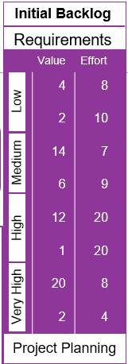
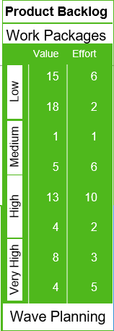
Initial and Product Backlog in Focused Build Definition
An Initial Backlog means to:
Define the content of the to be implemented Release
Have a list of approved and prioritized Requirements
A Product Backlog means to:
Define the content of the current Wave
Have a list of prioritized Work Packages
Responsible: Architect

Slide 37
Focused Build Methodology When to do Release and Wave Planning
= automated status setting
= manual status setting
Simplification Item
Created
Follow-Up Created
In Realization
Completed
Activity
Created
Follow-Up Created
In Realization
Completed
Project
Created
Released
Completed
Requirements
Draft
Approved
In Realization
Realized
Completed
Project Planning
Work Packages
Created
Scoping
To Be Developed
Handed over to Release
Productive/ Completed
Wave Planning

Slide 38
Demo

Slide 39
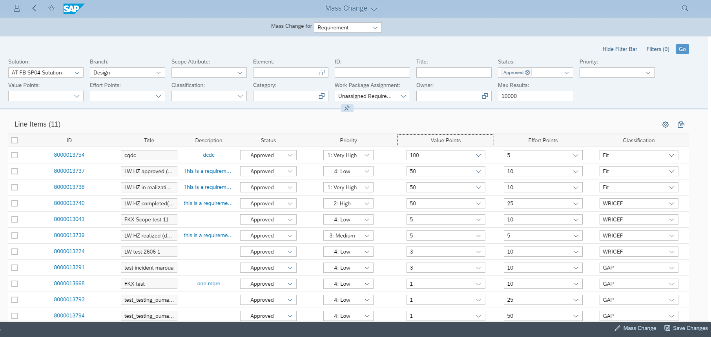
Define Initial Backlog Example: Use Mass Change Operations to Prioritize Requirements
Sort Values
Check and adjust Priority

Slide 40
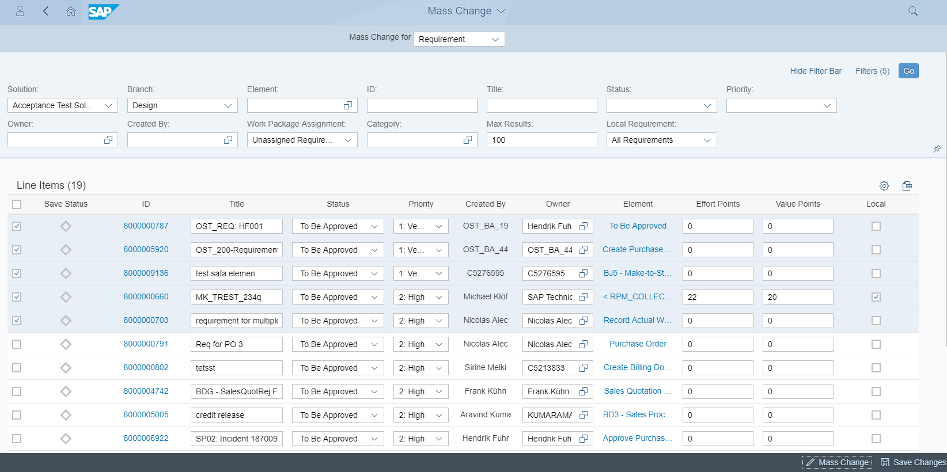
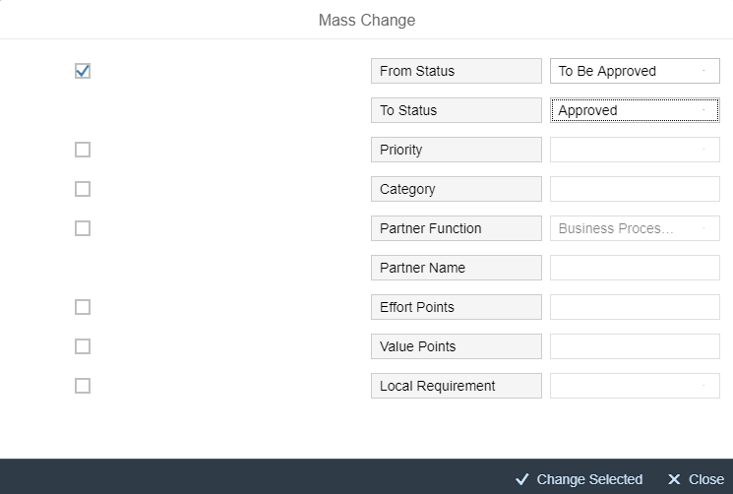
Define Initial Backlog Example: Use Mass Change Operations to Approve Requirements
Select all Requirements to be part of the Release
To define the Initial Backlog Change the Requirement Status to ‘Approved’
Notes:
Note: Mass Change is an excellent detailed reporting tool across all potential status values (even in FINI status), with display authorization for some FB roles, e.g. Developer

Slide 41
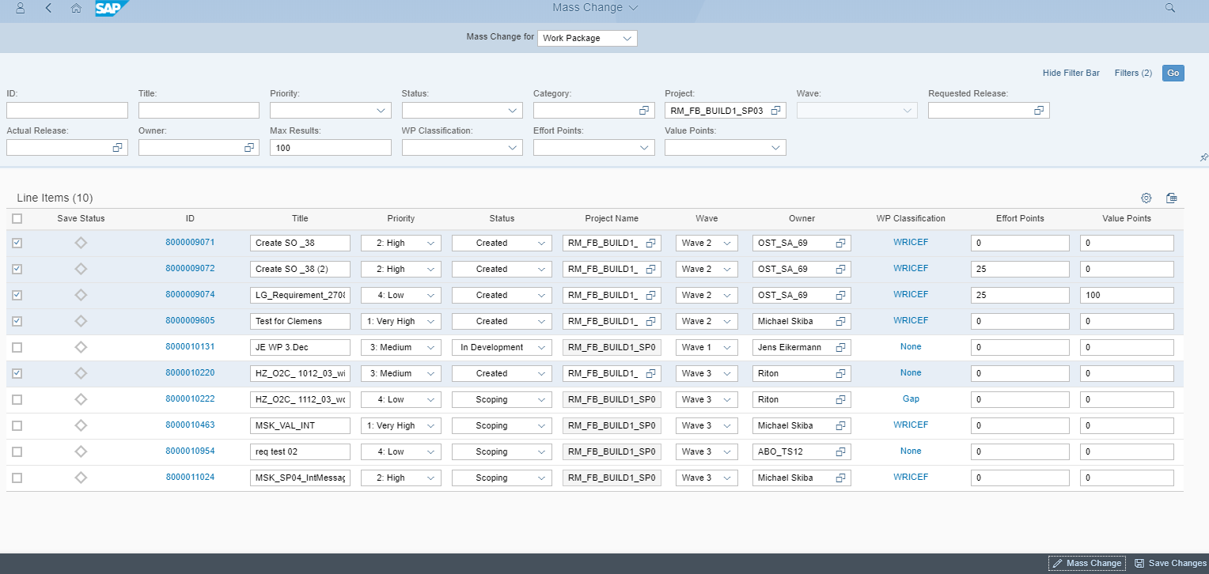
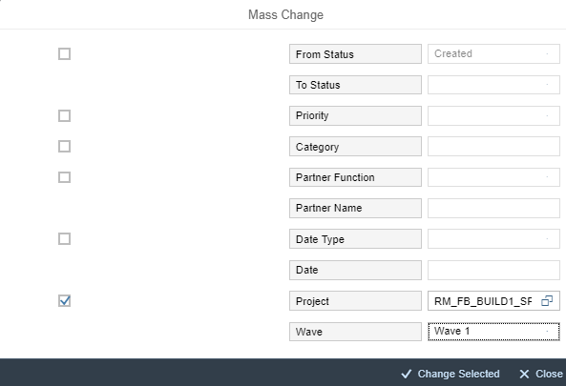
Define Product Backlog Example: Use Mass Change Operations to define the Scope of the first Wave
Select the (Build) Project
Select all Work Packages to be part of the Wave
To define the Product Backlog select the Wave

Slide 42
How to do project reporting with Focused Build

Slide 43

Solution Readiness Dashboard – Master Project
Aggregated data for all Build-Projects assigned to Master Project
Aggregated data per Build Project
Select Build Project

Slide 44
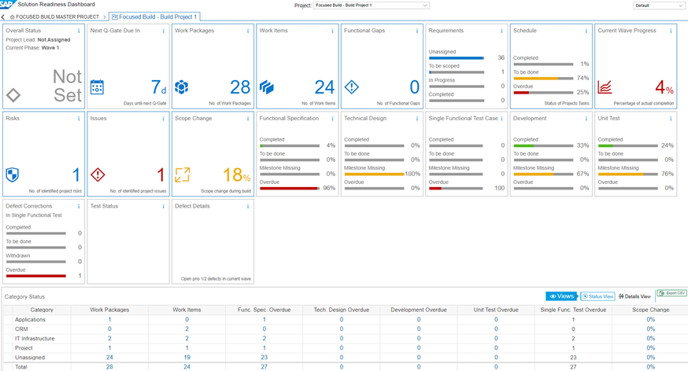
Solution Readiness Dashboard – Build Project
Aggregated for selected Build-Project
Aggregated data per Category

Slide 45
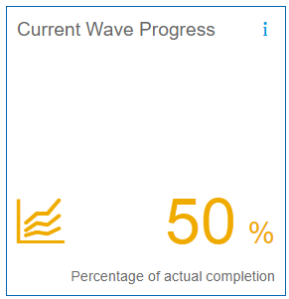
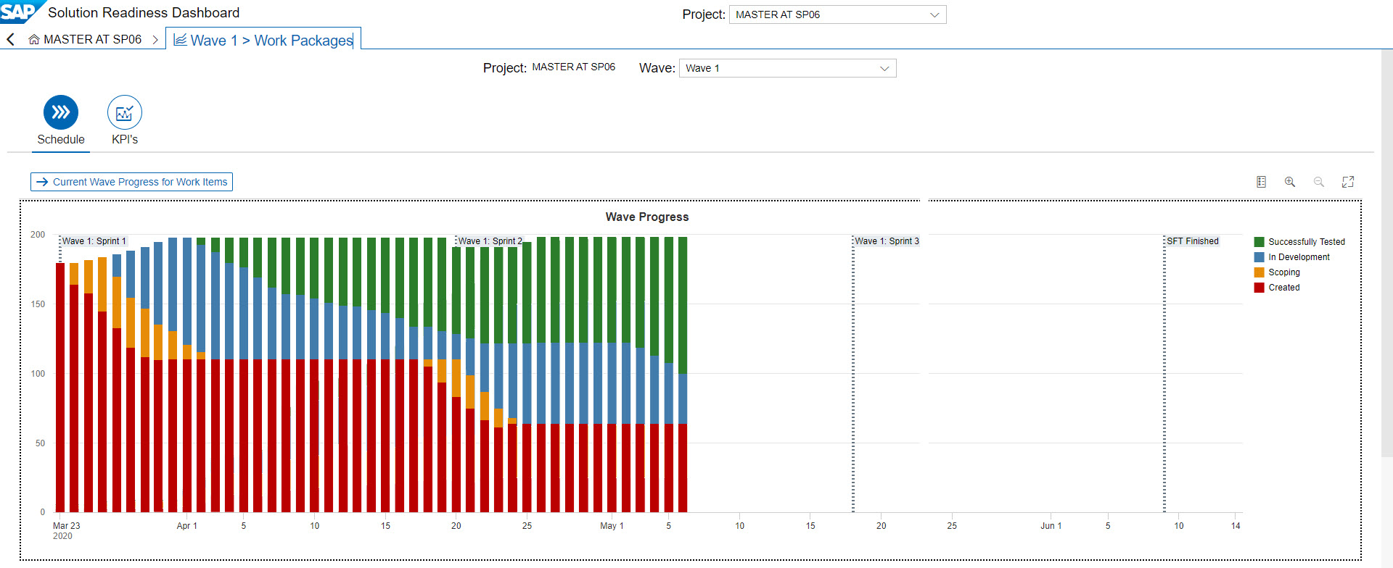
Current Wave Progress tile
Progress of work packages assigned to current wave.
The Schedule tab visualize the progress of the work packages of a current or selected wave. Timeline of sprints and Milestone for Single Functional Test. You can also display the progress for work items choosing by Current Wave Progress for Work Items and if needed drill down to Sprint level.
The KPIs tab shows the ratings for status and documentation of work packages
Work Packages status values are aggregated:
Successfully Tested: Successfully Tested, Handed over to Release, Productive, Complete
In Development: To be Developed, In Development, In Repair, To be Tested
Scoping: Scoping, Scope Finalized, Scope Extension
Created: Created

Slide 46
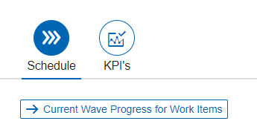
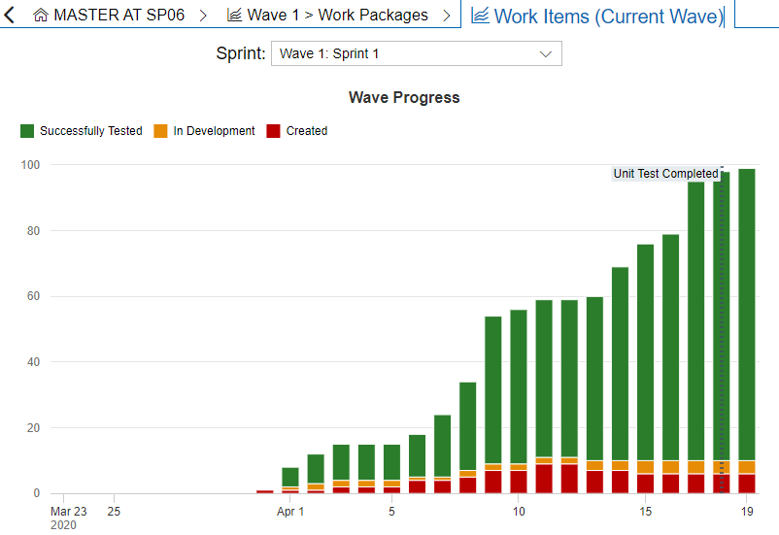
Current Wave Progress tile – Details about Work Items (new with Focused Build SP06)
Progress of work items assigned to current wave.
View progress of the work items of a current or selected wave with timeline of sprints and milestone for Single Functional Test. If you select dedicated Sprint the milestone for ‘Unit Test Completed’ is displayed.
Work Item status values are aggregated:
Successfully Tested: Successfully Tested, Handed over to Release, Productive, Completed
In Development: To be Developed, To be Tested
Created: Approved, Created

Slide 47
Demo

Slide 48
Q & A

Slide 49
Further Information

Slide 50

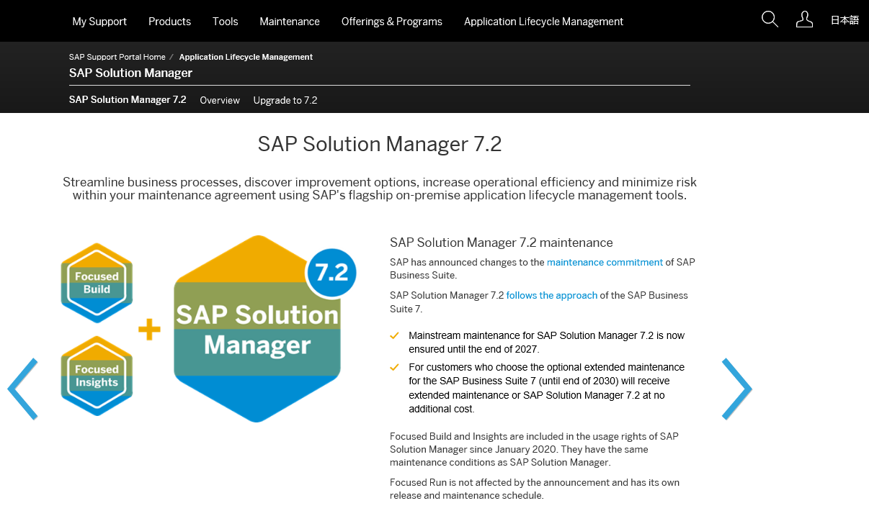
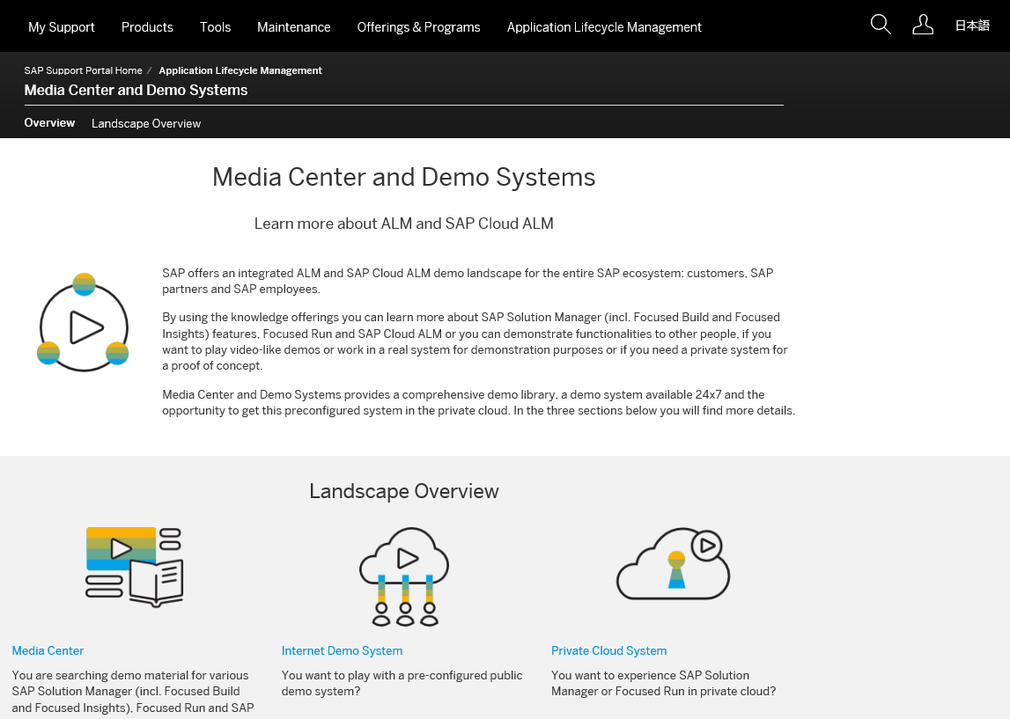
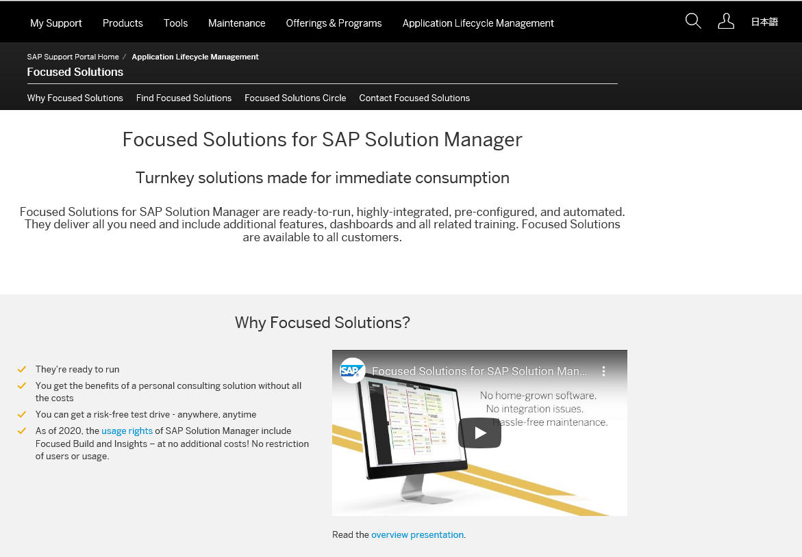
Enablers for Your Digital Transformation Focused Build and SAP Solution Manager
SAP Solution Manager
Launch page to access latest news and key sources of additional information
https://support.sap.com/en/alm/solution-manager.html
Media Center and Demo Systems
Access to Media Centre for presentations, videos, and the demo systems
https://support.sap.com/en/alm/demo-systems.html
Focused Build
News and content related to ‘Focused Build’ with SAP Solution Manager
https://support.sap.com/en/alm/focused-solutions/focused-build.html

Slide 51
Thank you.
Contact information:
henrik.zimmermann@sap.com
reiner.markheiser@sap.com
joerg.marenk@sap.com

